Slide 1
Using Access to Hack Your Data
If you really want to…

Slide 2
Welcome
Logan Rath, MLS
Resource Sharing Librarian
Brockport (XBM)
585-395-2568
lrath@brockport.edu

Slide 3
Warning: Advanced Users Only
This presentation is just to give you an idea of what’s possible.
Unless you’re intimately familiar with SQL and building Access queries, either find a friend or book.

Slide 4
Why Use Access
Deeper analysis of data
Automatically updated queries
Set something up once and you’ll be good to go.
Relative Criteria (one year ago, last three months)

Slide 5
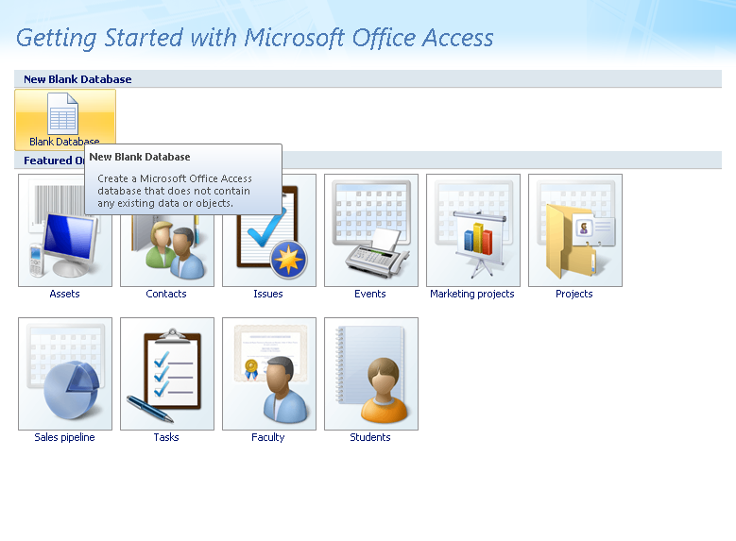
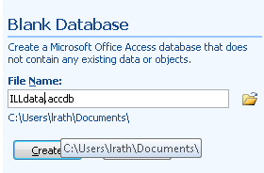
Setting up Access
Open Access
Create a Blank Database on your computer.

Slide 6
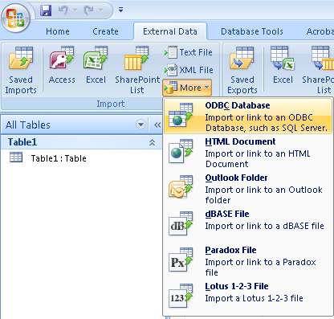
Setting up Access
Under External Data, choose ODBC Database
Create a Linked Database
Create a New Machine Data Source

Slide 7
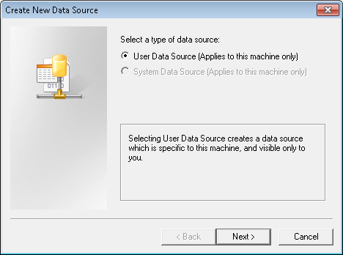
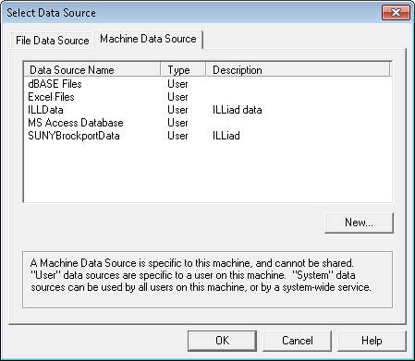
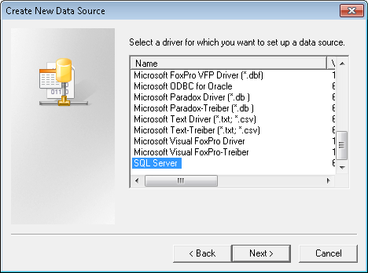
Setting up Access
On the Machine Data Source tab, choose New
The type will be User Data Source
The driver will be SQL (last choice)

Slide 8
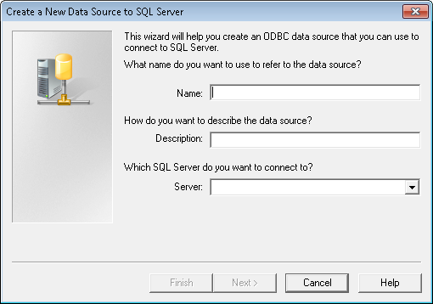
Setting up Access
Name your database. (This can be anything)
Give it a description.
Enter your SQL server IP
Your server IP can be found by adding going to your ILLiad Logon page URL and replacing /illiad/logon.html with /Setup/default.html
e.g. http://brockport.illiad.oclc.org/Setup/default.html

Slide 9
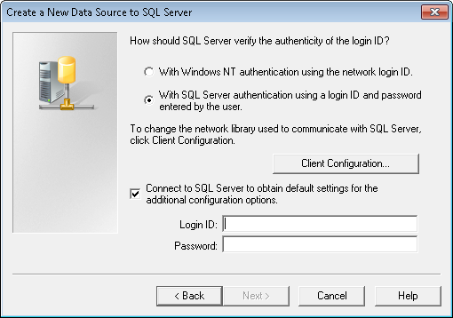
Setting up Access
Choose SQL Server authentication.
Leave the Connect to SQL Server box checked.
Enter your credentials (obtained from ILLiad host).

Slide 10
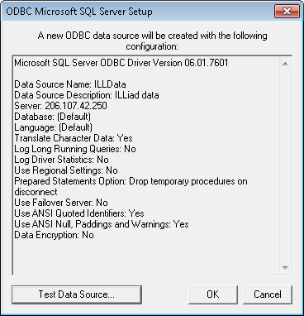
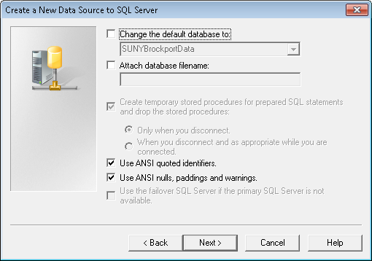
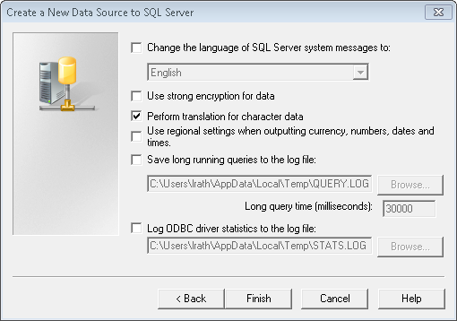
Setting up Access
Leave all the other options default.

Slide 11
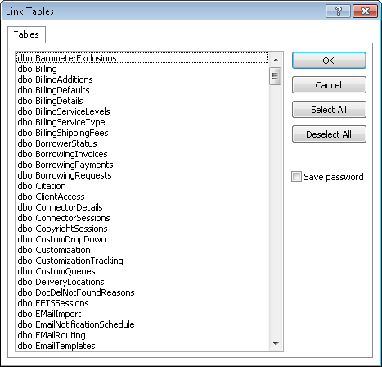
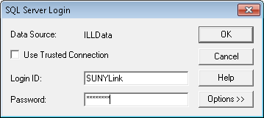
Import Linked Fields
Step 1: Log into the database.
Step 2: Pick the tables to link
You’ll see every table in the Customization Manager. Only the dbo_ tables are important.
dbo_Transactions
dbo_Users (etc)

Slide 12
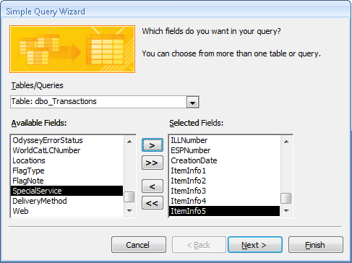
Creating Queries
On the Create menu, choose Query Wizard.
Add the fields you want to see in the end report, and any fields you want to operate against.

Slide 13
Add Fields
Add the fields you want to see in your results (and any fields you want to query against).

Slide 14
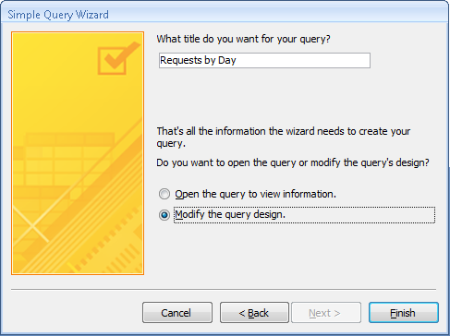
Name your Query
The name shows up on the left hand side.
You can query queries (results sets).

Slide 15
Add Criteria

Slide 16
Create Expressions
Expressions can perform calculations or operations on fields.
Exp1: Operations
Day: Format([dbo_Transactions.CreationDate],"dddd")
Returns day of week for any Transaction
Weekday([dbo_Transactions.CreationDate])
Returns day number (0 – 6) for a Transaction

Slide 17
Common Date Functions
Interval | Explanation
yyyy | Year
q | Quarter
m | Month
y | Day of year
d | Day
w | Weekday
ww | Week
h | Hour
n | Minute
s | Second
Expression | Description
=Date() | Displays the current date in the form of mm-dd-yyyy, where mm is the month (1 through 12), dd is the day (1 through 31), and yyyy is the year (1980 through 2099).
=Now() | Displays the current date and time.
=Date() - 1 | Displays yesterday's date.
=Year(Date()) | Displays the current year.
Notes:
Also see: http://office.microsoft.com/en-us/access-help/add-to-or-subtract-from-date-and-time-values-HP001098485.aspx

Slide 18
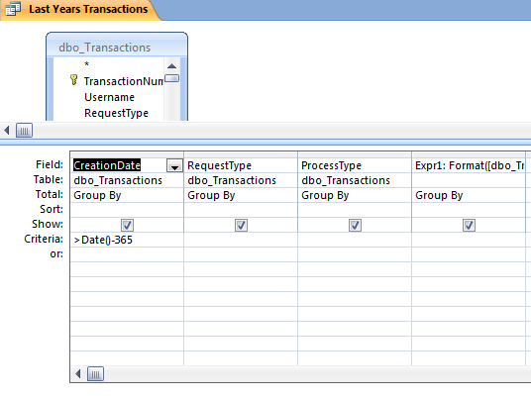
Set up a Query for Last Year
Select all the fields to show up in the query.
On the criteria line input the calculation.

Slide 19
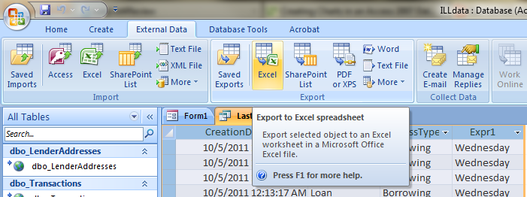
Export to Excel
Charts don’t work well with Linked Data. ☹
Under External Data, Export to Excel

Slide 20
Calculate REALLY OVERDUE items
Step 1: Calculate all Borrowing Loans where the Due Date is less than 5 weeks.
Criteria:
DueDate < DateAdd("ww",-5,Date())

Slide 21
Copyright Compliance Queue
Step 1: Query for all Articles Borrowed for the last calendar year.
Criteria:
ProcessType is "Borrowing"
CopyrightAlreadyPaid is "No"
CreationDate is Between #1/1/2011# And #12/31/2011#
PhotoJournalYear > Year(Date()-"5")

Slide 22
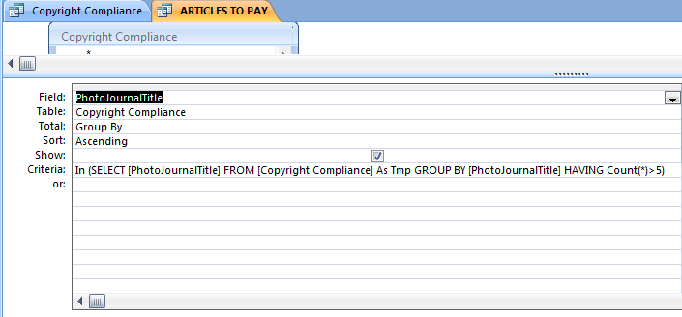
But which ones do we have to pay?
We need to query a query:
Create another query to sort through Copyright Compliance queue (I named mine Articles to Pay).
This query has a subquery.
Notes:
In (SELECT [PhotoJournalTitle] FROM [Copyright Compliance] As Tmp GROUP BY [PhotoJournalTitle] HAVING Count(*)>5)

Slide 23
Questions?
Logan Rath, MLS
Resource Sharing Librarian
Brockport (XBM)
585-395-2568
lrath@brockport.edu

